Slide 1

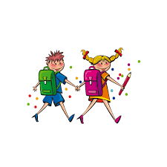
Going Back to School

Slide 2

Coronavirus is a new virus that makes people unwell. To help stop the virus from spreading, almost everyone has had to stay home.

Slide 3
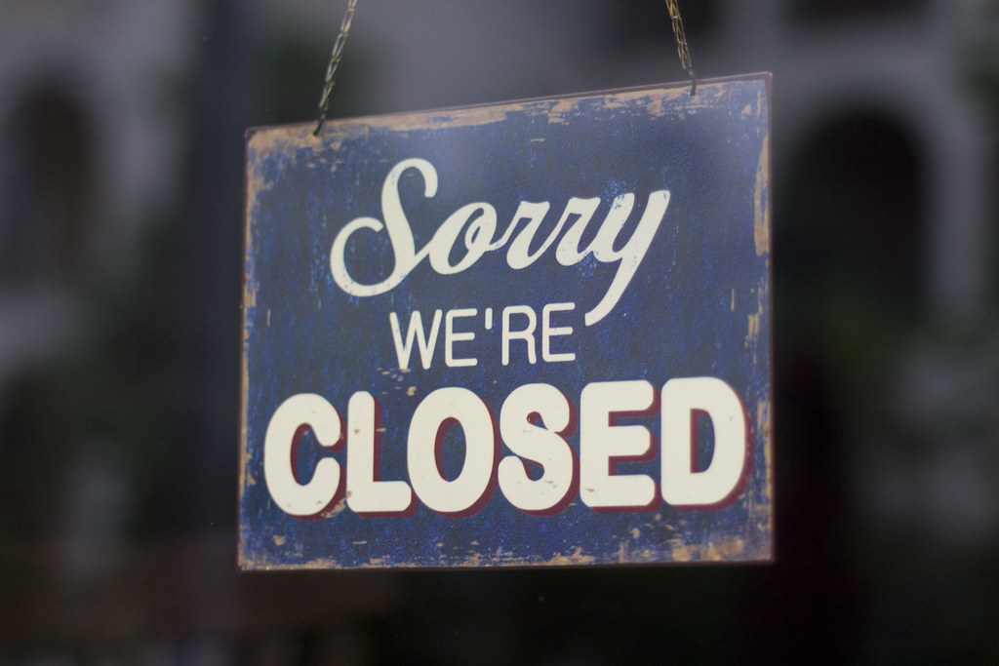
Schools have been closed. Lots of other places have been closed too.

Slide 4
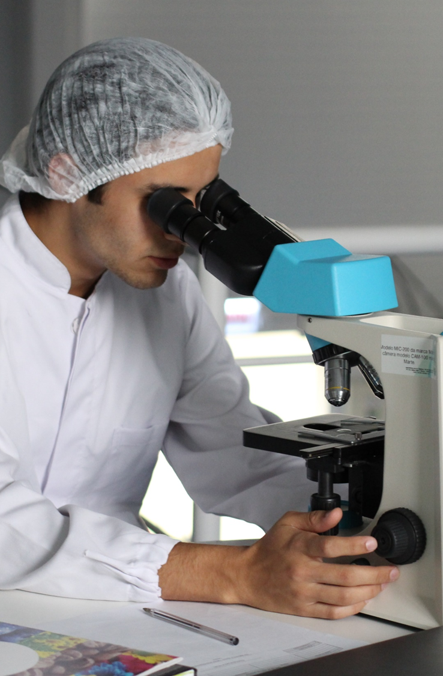
Scientists have been working hard to find out more about the coronavirus. Scientists say it is now safe for most children to go back to school.

Slide 5
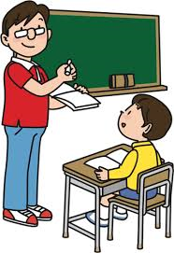
I am going back to school. Going back to school might be a bit different than before. This is to keep everyone safe and stop the virus from spreading.
Many things will stay the same. My parents and teachers will know what will be different and what will stay the same. They can tell me.

Slide 6
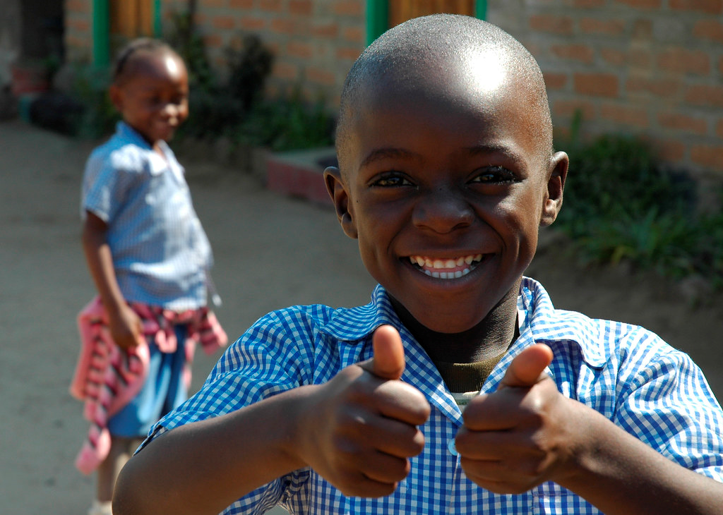
Scientists say it is now safe for most children to go back to school. School might be a bit different when I go back but lots of things will stay the same.

