Slide 1

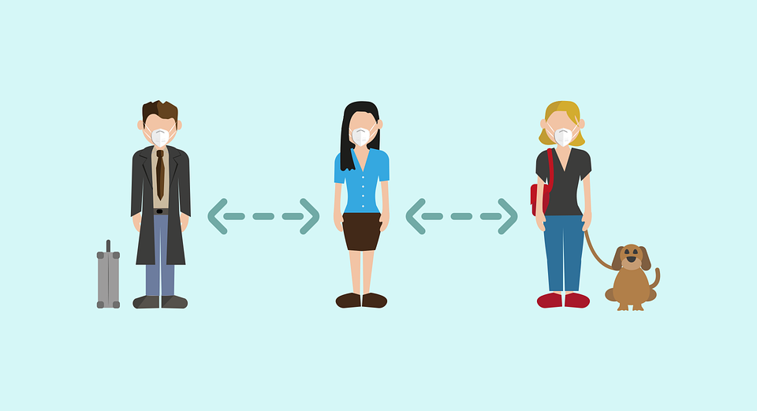
Why do we have to stay away from other people?

Slide 2
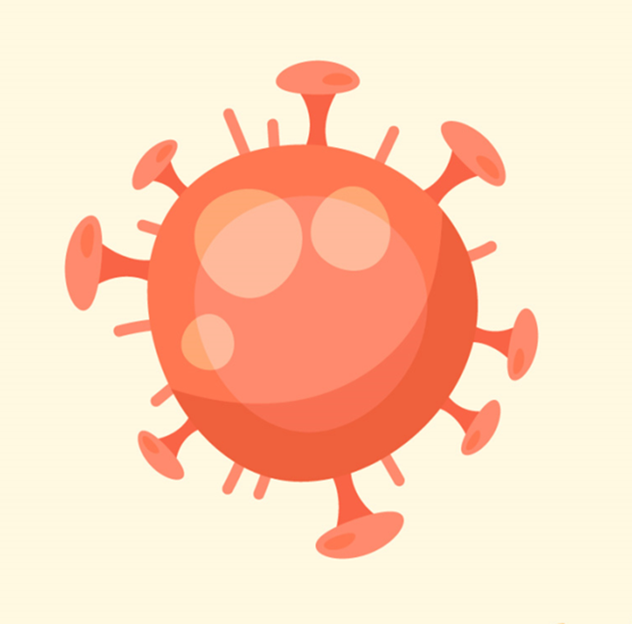
COVID-19 is a new virus that makes people unwell. COVID-19 is sometimes called coronavirus. Because it is new, lots of people have become ill with the virus.

Slide 3
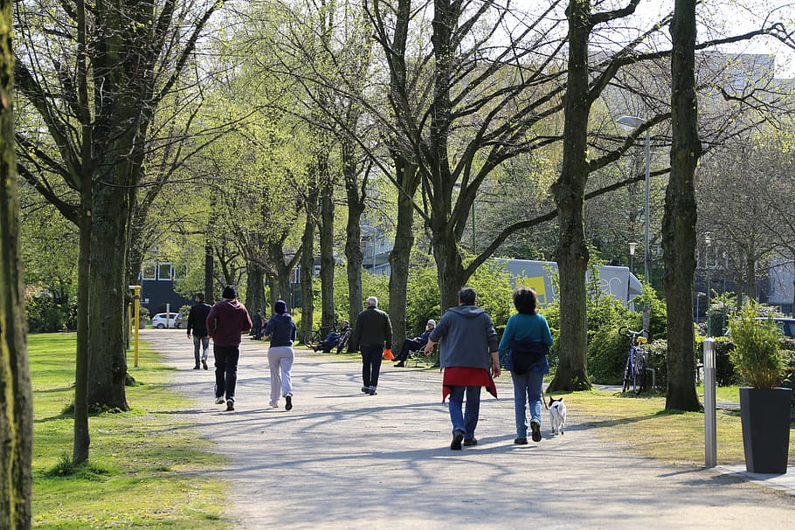
Scientists say we have to keep away from people we do not live with. This is to help keep us well and stop the virus from spreading.

Slide 4
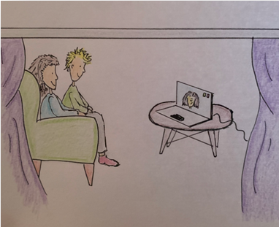
I will try to keep away from people that I do not live with. Mum or dad can help me. I can still talk to my friends and family on the phone or on a video call.

Slide 5
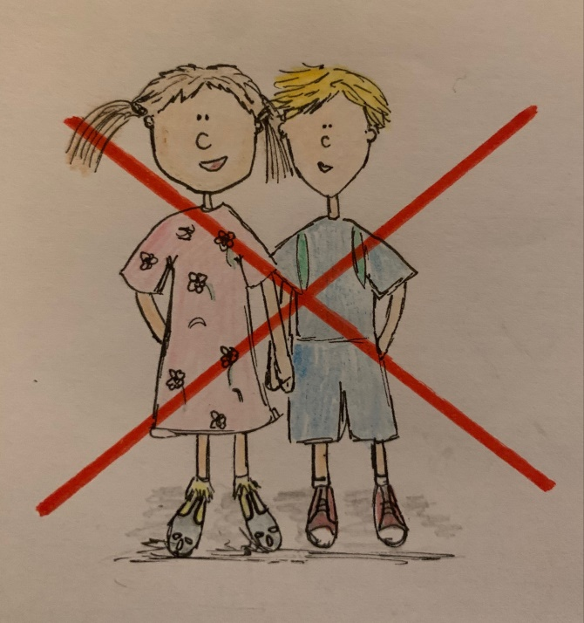
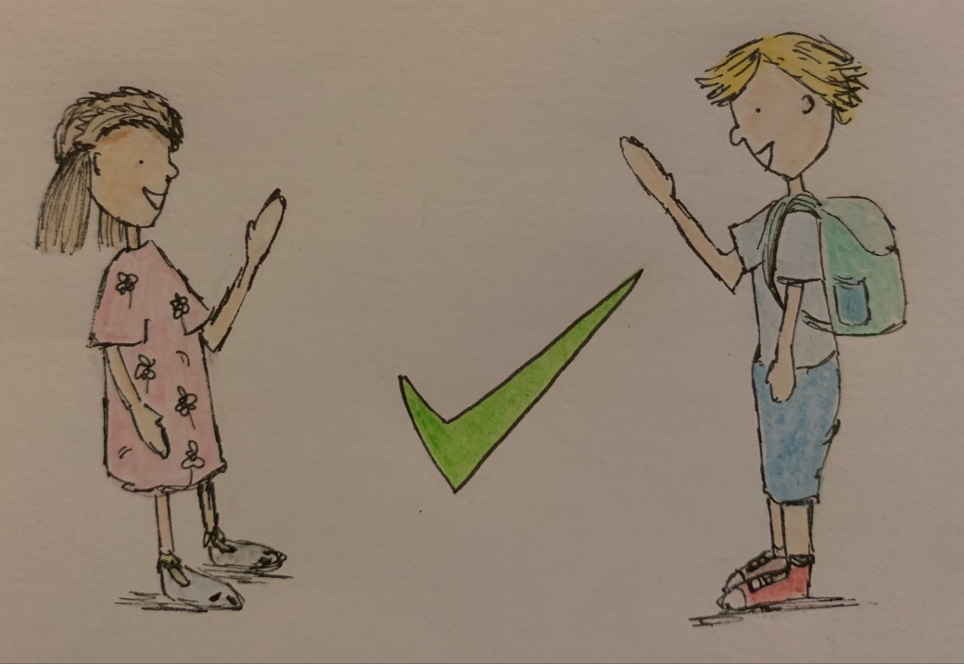
If I see someone I know, it is not safe for me to hug them or touch them. It is ok to wave and say hello.

Slide 6
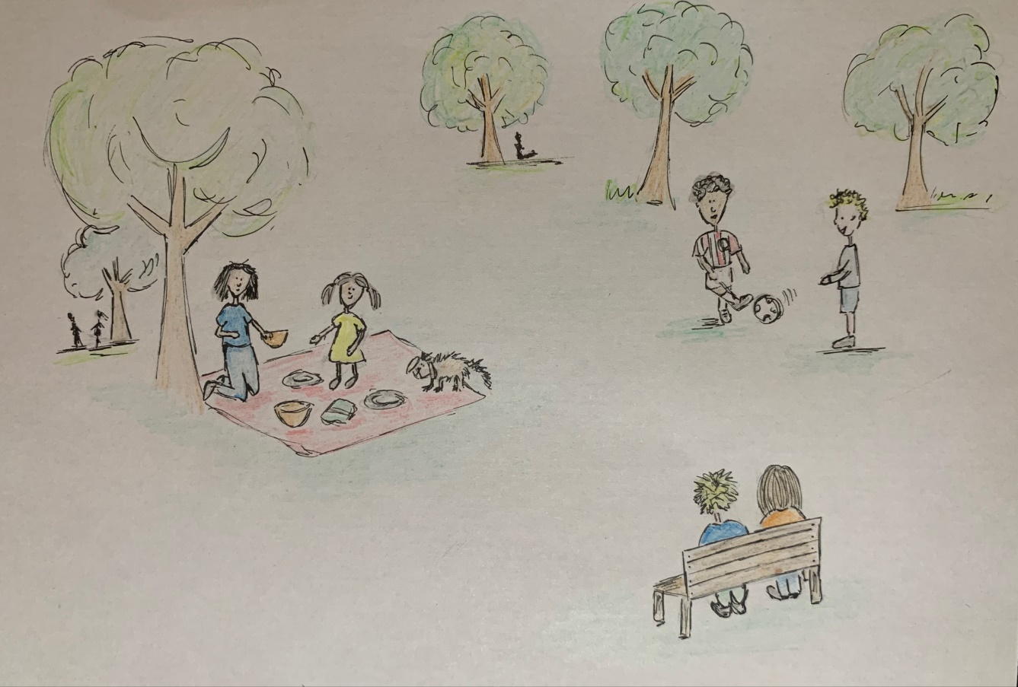
Scientists say we have to keep away from people that we do not live with. This is to help stop the coronavirus from spreading. Mum or dad can help me.

