Slide 1

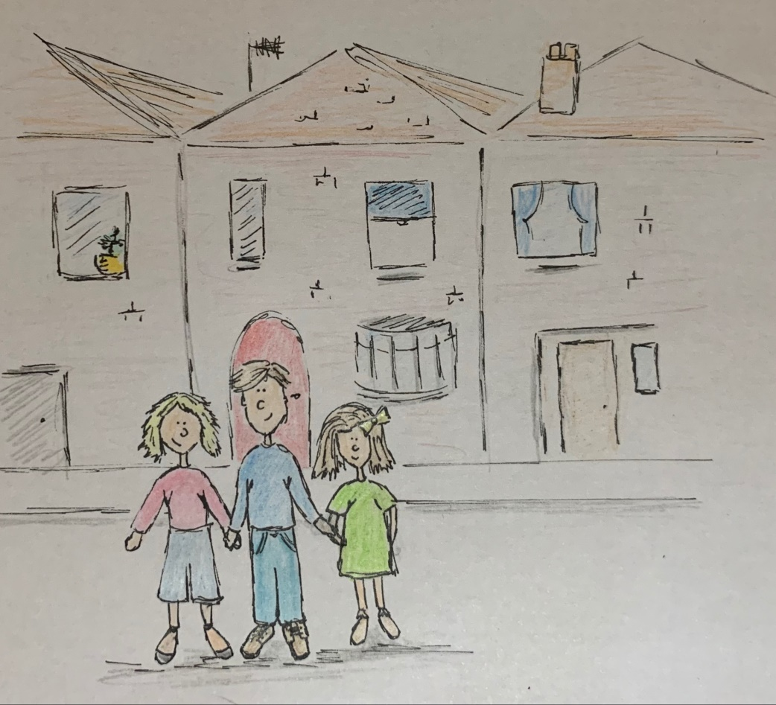
Why is it safe to go out now?

Slide 2

COVID-19 is a new virus that makes people unwell. COVID-19 is sometimes called coronavirus. To help stop the virus from spreading, almost everyone has had to stay home.

Slide 3

Schools have been closed. Lots of other places have been closed too.

Slide 4
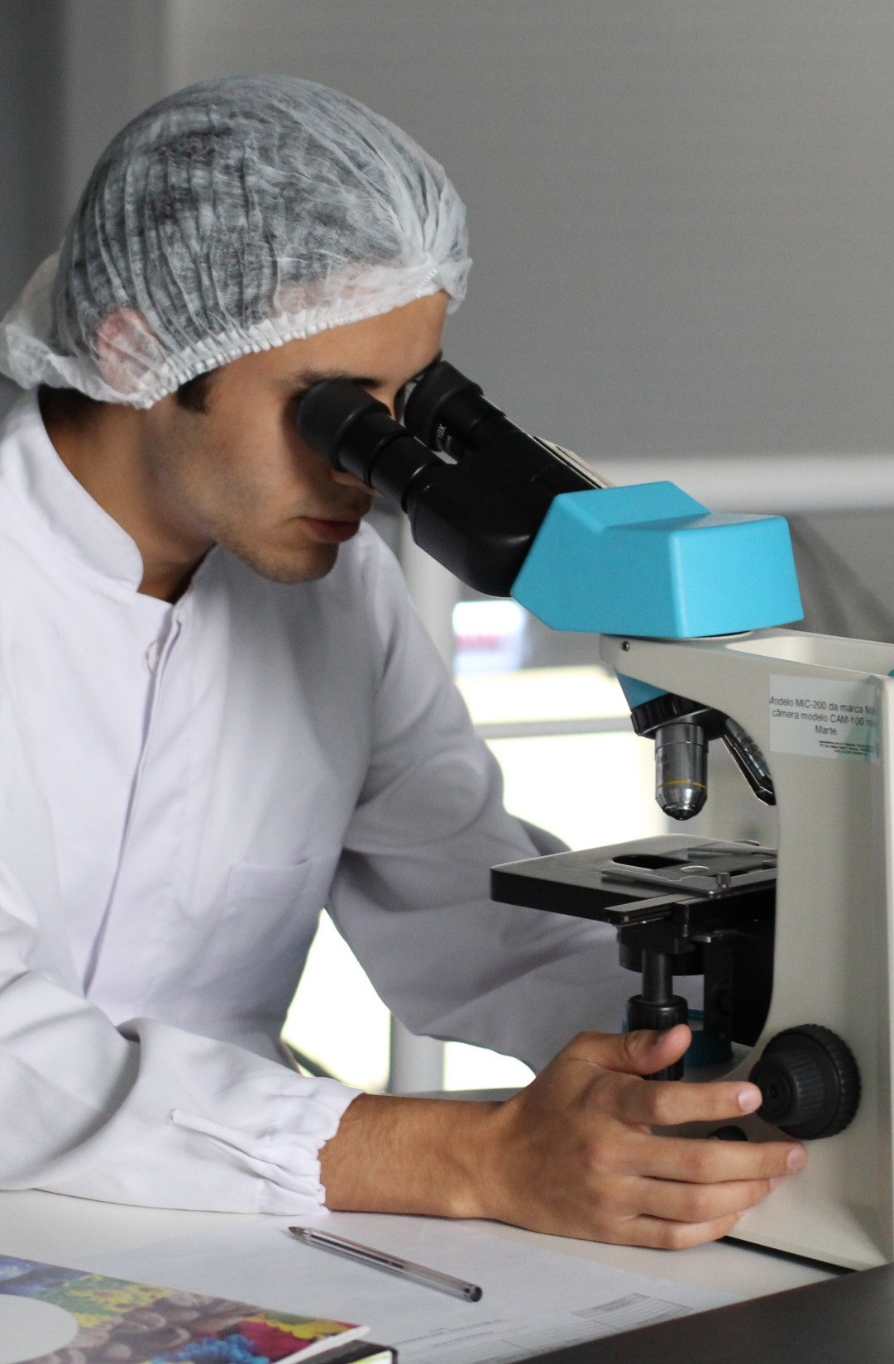
Scientists have been working hard to find out more about the coronavirus. Scientists have also been counting how many people have been getting ill with coronavirus.

Slide 5


The number of people becoming ill with coronavirus is getting lower and lower. Scientists say it is now safe for some places to re-open. Not everywhere will be open straight away. Mum or dad will know which places are open.

Slide 6

Scientists say it is safe for us to go out now. We can only go to certain places for now. Mum or dad will know where we can go.

